Slide 1
Results summary
April 2015
V1: n=12, immediate memory test
V2: n=13: Delayed memory test (5 day delay)

Slide 2
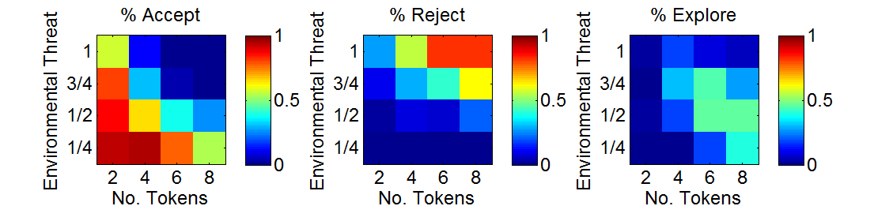
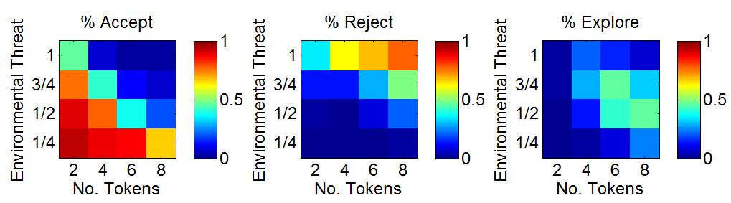

Choice
P(Explore) - for working out which group-level cells to include for ExploreOr
Include all cells where 0 .4 < p(Explore) < 60
V1-1
0.026 0.177 0.0885 0.0469
0.0104 0.307 0.443 0.266
0.0156 0.177 0.458 0.458
0 0.0104 0.177 0.391
V1-2
0.0192 0.207 0.149 0.0721
0.024 0.293 0.466 0.322
0.00962 0.135 0.409 0.466
0 0.024 0.0865 0.245
Combined
0.0225 0.193 0.12 0.06
0.0175 0.3 0.455 0.295
0.0125 0.155 0.433 0.463
0 0.0175 0.13 0.315
P(Explore) - for working out which group-level cells to include for ExploreOr
Include all cells where 0 .25 < p(Explore) < 60
V1-1
0.026 0.177 0.0885 0.0469
0.0104 0.307 0.443 0.266
0.0156 0.177 0.458 0.458
0 0.0104 0.177 0.391
V1-2
0.0192 0.207 0.149 0.0721
0.024 0.293 0.466 0.322
0.00962 0.135 0.409 0.466
0 0.024 0.0865 0.245
Combined
0.0225 0.193 0.12 0.06
0.0175 0.3 0.455 0.295
0.0125 0.155 0.433 0.463
0 0.0175 0.13 0.315
V1-1
V1-2
Both v1 and v2

Slide 3
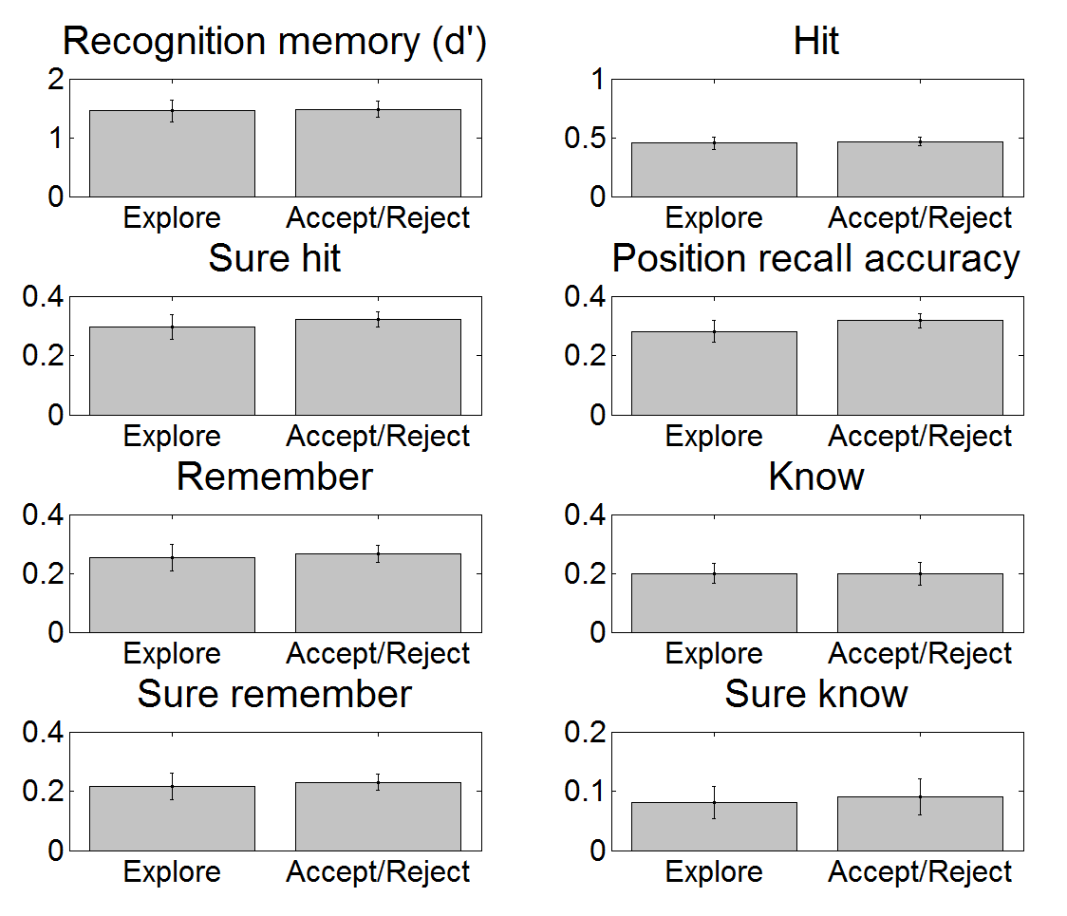
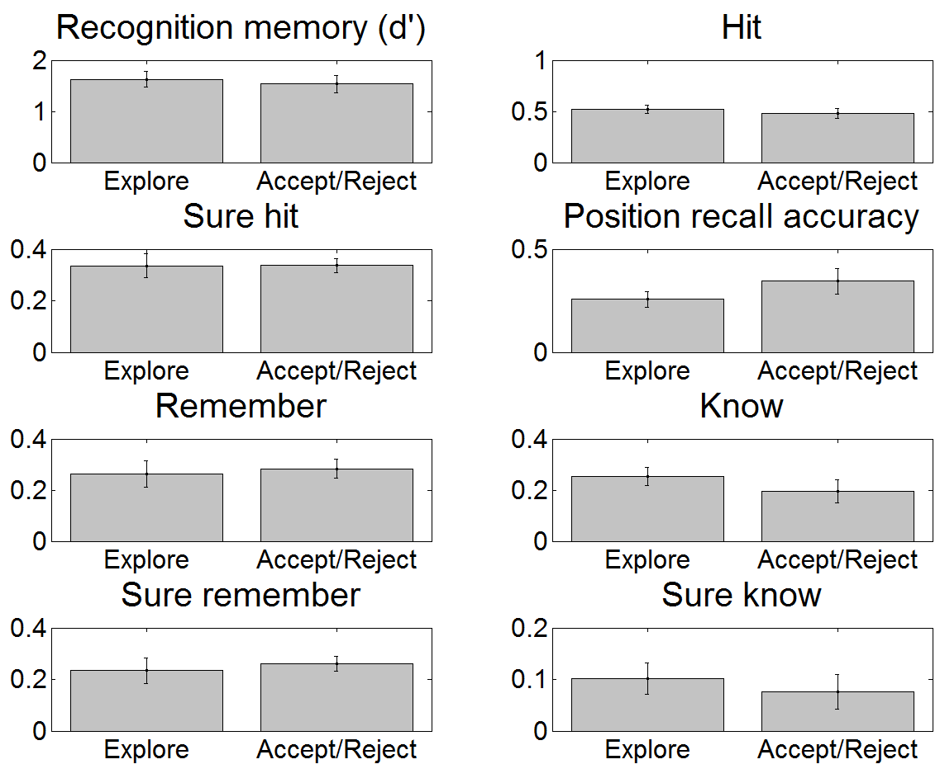
[V1] Explore Or (same cells for all subjects)
Inclusion criteria: p(Explore)>0.4 (group level)
3 Cells (E,N): [2 3; 2 4;3 3]
All nsf p>.1
No. trials Explore=21 (SD=9.84), Or=21.58 (SD=10.49)
Explore Or
5 42
15 25
33 11
18 14
11 31
34 12
21 20
14 32
24 20
35 6
14 29
28 17
Inclusion criteria: p(Explore)>0.25 (group level)
6 Cells (E, N): [1 4; 2 3; 2 4; 3 2; 3 3; 3 4];
All nsf p>.4
No. trials: (mean/sd):
Explore=35.67 (SD=14.57), Or= 49.58 (SD=15.07)
Explore Or
15 76
29 52
56 33
30 42
19 63
53 40
28 56
27 61
33 56
58 20
31 55
49 41
Notes:
Statistics (p, t. df=11)
Cell criteria: >0.25
dprime 0 0.801068730124029 -0.258134813438808
hit 0 0.771954938863012 -0.297060242251203
surehit 0 0.622739014528905 -0.506153401422678
assoc 0 0.402353752462277 -0.871018247189613
rem 0 0.715612644854275 -0.373862291176716
know 0 0.980748994439498 0.0246841588639882
surerem 0 0.725695943305539 -0.359955742203793
sureknow 0 0.696091907103311 -0.401010599826109
Cell criteria: >0.4
dprime 0 0.396208412722601 0.882836261158613
hit 0 0.332509210566082 1.01368931852976
surehit 0 0.976503085958481 -0.0301300123042959
assoc 0 0.161404307479548 -1.50138647421889
rem 0 0.627182687879856 -0.499623758560236
know 0 0.218635091260748 1.30468640233350
surerem 0 0.536133437066670 -0.638630775949028
sureknow 0 0.342818587199287 0.991354856197858

Slide 4
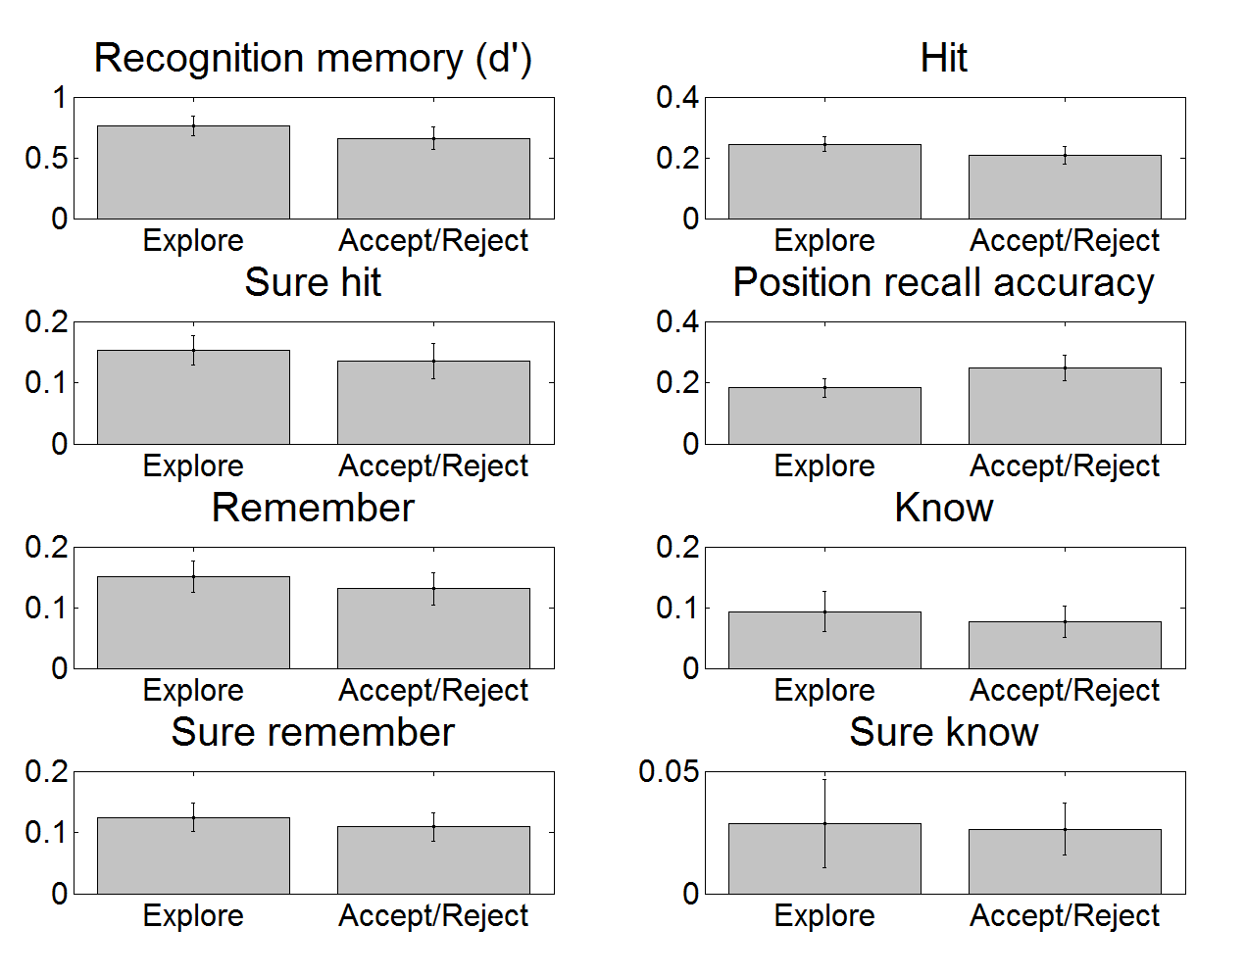
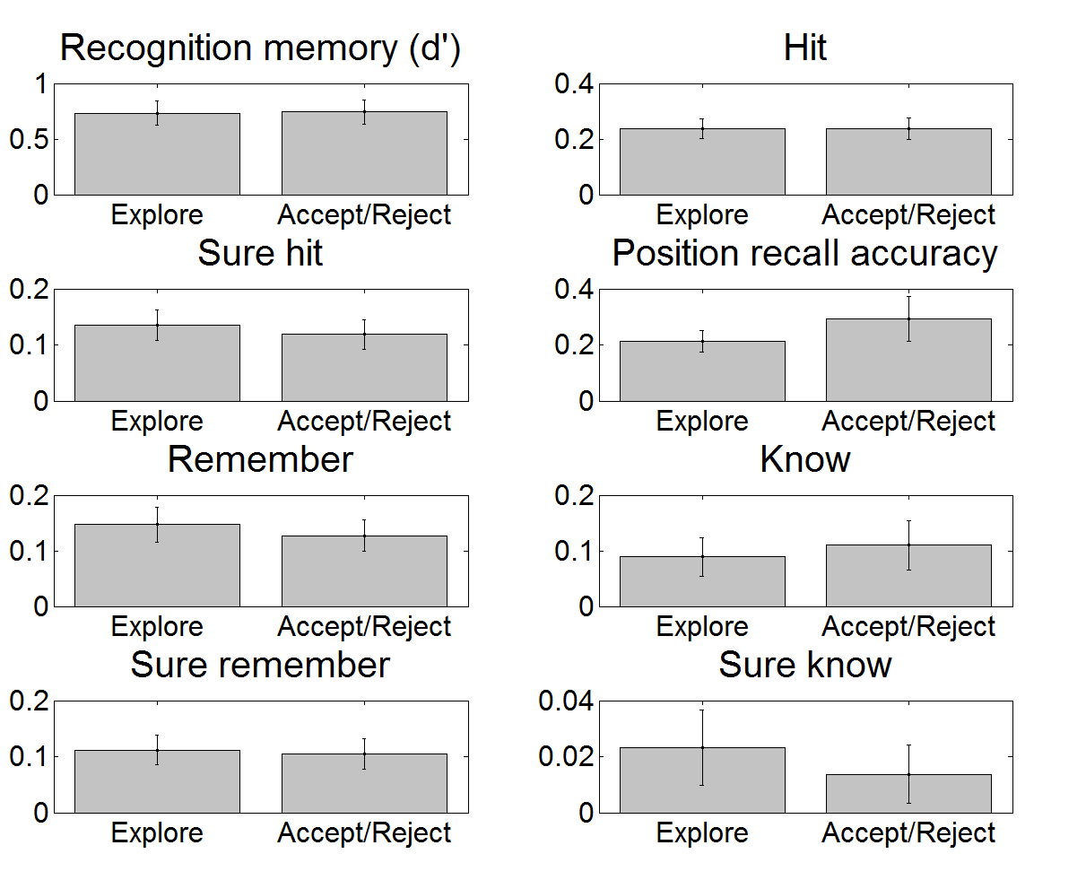
[V2] Explore Or (same cells for all subjects)
Inclusion criteria: p(Explore)>0.4 (group level)
3 Cells (E,N): [2 3; 2 4;3 3]
All other nsf p>.4
No. trials Explore=20.46 (SD=7.60), Or=20.85 (SD=6.77)
Explore Or
12 22
27 18
22 19
17 25
15 21
24 16
20 17
18 27
19 26
13 32
41 6
15 27
23 15
Inclusion criteria: p(Explore)>0.25 (group level)
6 Cells (E, N): [1 4; 2 3; 2 4; 3 2; 3 3; 3 4];
All nsf p>.2
No. trials: Explore= 33.31 (SD=10.62), Or= 49.46 (SD=9.90)
Explore Or
19 54
43 40
42 44
26 61
31 42
38 46
26 42
29 60
39 50
28 64
59 30
29 52
24 58
Notes:
Statistics (p, t. df=11)
Cell criteria: >0.25
dprime 0 0.264885676859883 1.16955686288074
hit 0 0.266090435544493 1.16645261838208
surehit 0 0.552361545021168 0.611368600650911
assoc 0 0.302004771606245 -1.07851874434854
rem 0 0.582417810219491 0.565098235463450
know 0 0.621066940379765 0.507404542016286
surerem 0 0.614291597294017 0.517384450369252
sureknow 0 0.855264088236410 0.186375260210741
Cell criteria: >0.4
dprime 0 0.921382975778846 -0.100788207561853
hit 0 0.988818695681757 -0.0143088877245462
surehit 0 0.637254022744581 0.483774318579217
assoc 0 0.449140702088286 -0.782405279826134
rem 0 0.620657233367798 0.508006499784789
know 0 0.696746415153908 -0.399217538998894
surerem 0 0.845700085963761 0.198862154578618
sureknow 0 0.431213447245795 0.814523048882038

Slide 5
Explore Or (same cells for all subjects): Compare v1 and v2
Threshold for cell inclusion p(Explore) > 0.4
Threshold for cell inclusion p(Explore) > 0.25
Repeated measures ANOVA: ExploreOr, Condition | ME Condition | ExploreOr x Cond
dprime | sig | Nsf
hit | Sig | Nsf
surehit | Sig | Nsf
assoc | Sig | nsf
rem | Sig | Nsf
know | Sig | Nsf
surerem | Sig | Nsf
sureknow | sig | Nsf
Repeated measures ANOVA: ExploreOr, Condition | ME Condition | ExploreOr x Cond
dprime | sig | Nsf
hit | Sig | Nsf
surehit | Sig | Nsf
assoc | Sig | nsf
rem | Sig | Nsf
know | Sig | Nsf
surerem | Sig | Nsf
sureknow | sig | Nsf

Slide 6
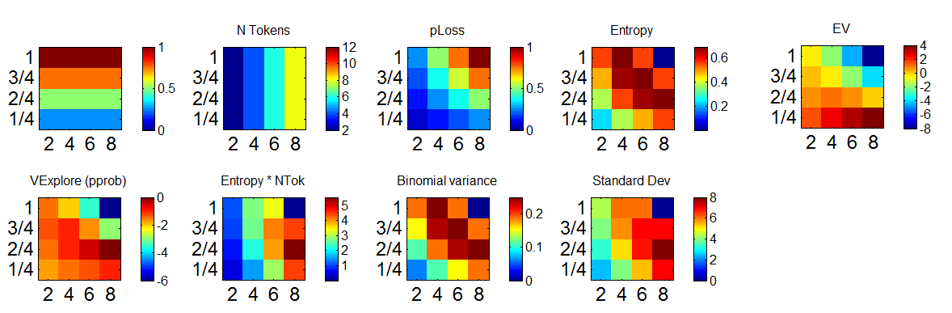
MODEL BASED ANALYSIS
Variables defining task space

Slide 7
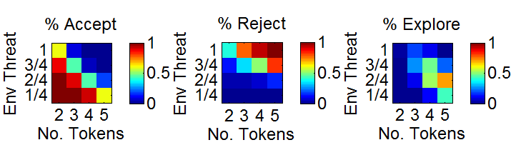
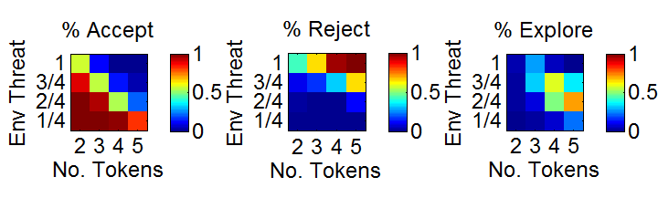
Predicted choice (from winning models)
V1 – bpjm10_fow
V2 – bpj16_feow
Psuedo r2: 0.54
BIC: 3066
Pseudo r2: 0.52
BIC: 3489
Notes:
Procedure: fixed procedure on all models, then top10 hierarchical procedure for each

Slide 8
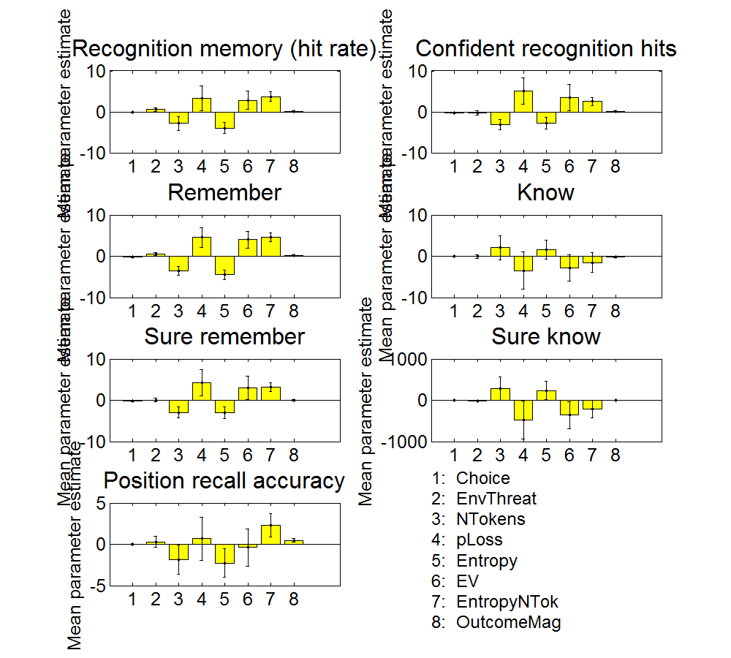
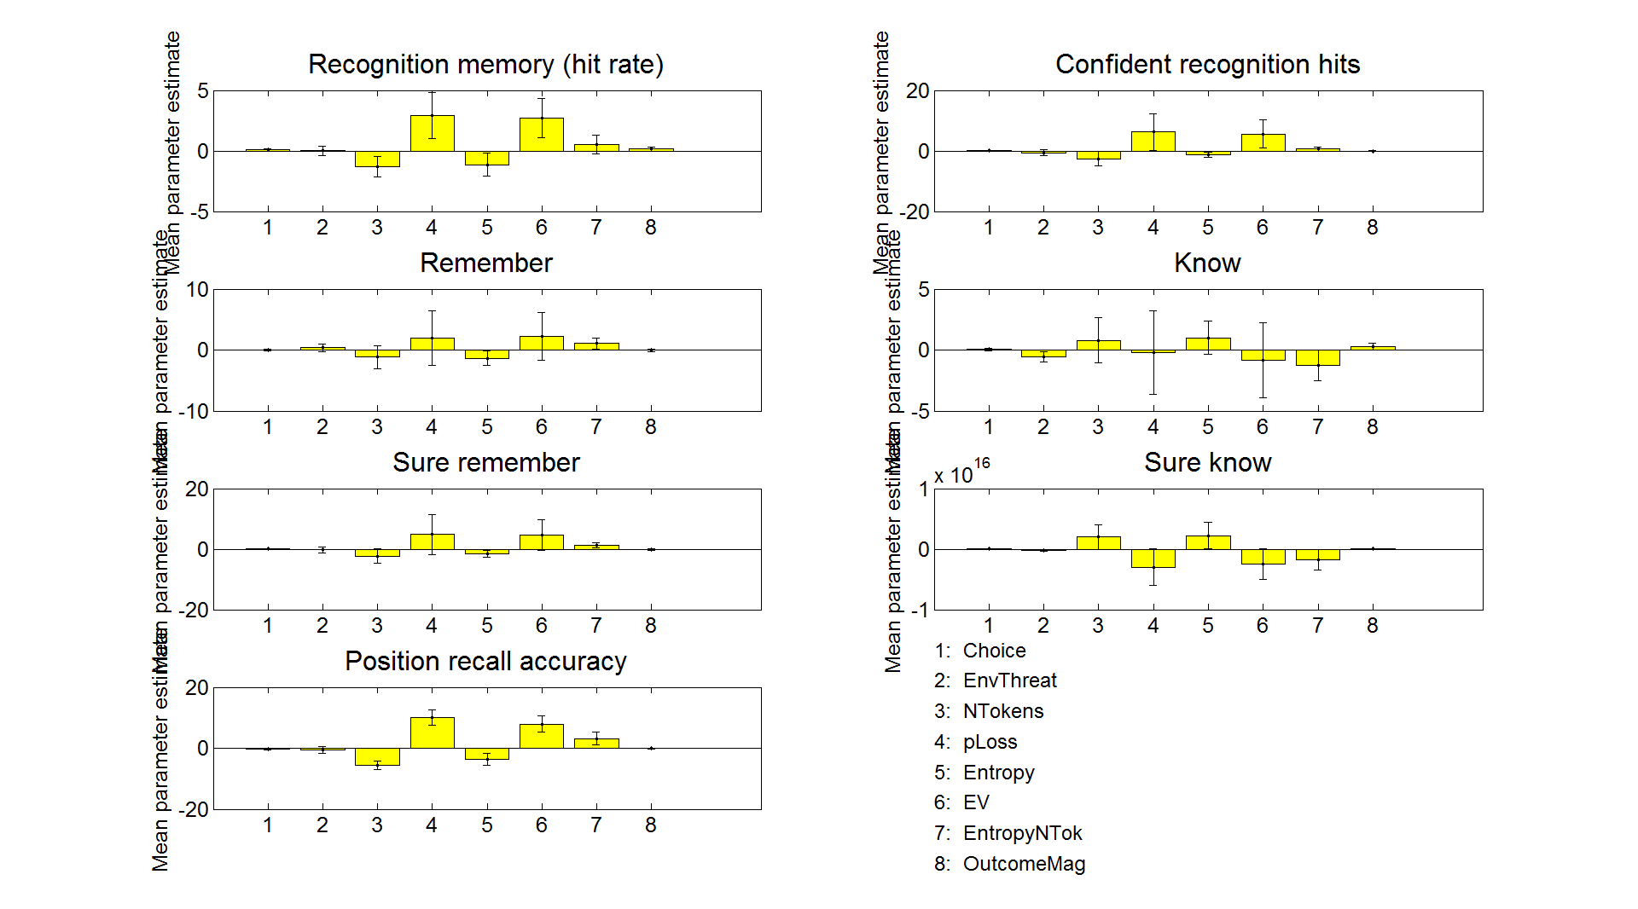
Mean betas
(EnvThreat is allowed to be distorted, f is taken as the subjects fitted f value)
v2
v1
v2
Df=11 | Choice | EnvThreat | NTokens | pLoss | Entropy | EV | EntropyNTok | OutcomeMag
hit | - | - | - | - | t= -2.82, p=0.0166 | - | t= 3.17, p=0.00884 | -
surehit | - | - | t= -2.49, p=0.0301 | - | - | - | t= 2.66, p=0.0223 | -
rem | - | - | t= -3.25, p=0.00767 | - | t= -3.7, p=0.00352 | - | t= 4.25, p=0.00137 | -
know | - | - | - | - | - | - | - | -
surerem | - | - | - | - | t= -2.21, p=0.0496 | - | t= 3.03, p=0.0115 | -
sureknow | - | - | - | - | - | - | - | -
assoc | - | - | - | - | - | - | - | -
Df=12 | Choice | EnvThreat | NTokens | pLoss | Entropy | EV | EntropyNTok | OutcomeMag
hit | - | - | - | - | - | - | - | -
surehit | - | - | - | - | - | - | - | -
rem | - | - | - | - | - | - | - | -
know | - | - | - | - | - | - | - | -
surerem | - | - | - | - | - | - | - | -
sureknow | - | - | - | - | - | - | - | -
assoc | - | - | t= -3.84, p=0.00234 | t= 3.98, p=0.00183 | - | t= 2.95, p=0.0121 | - | -

Slide 9
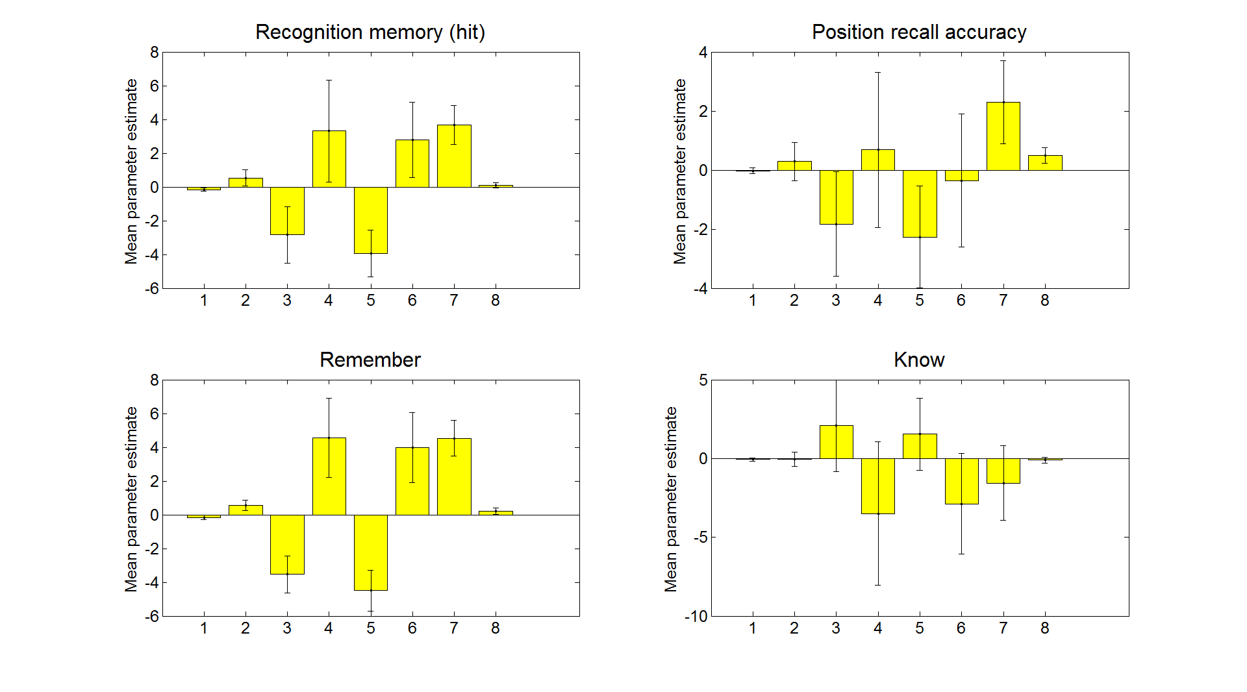
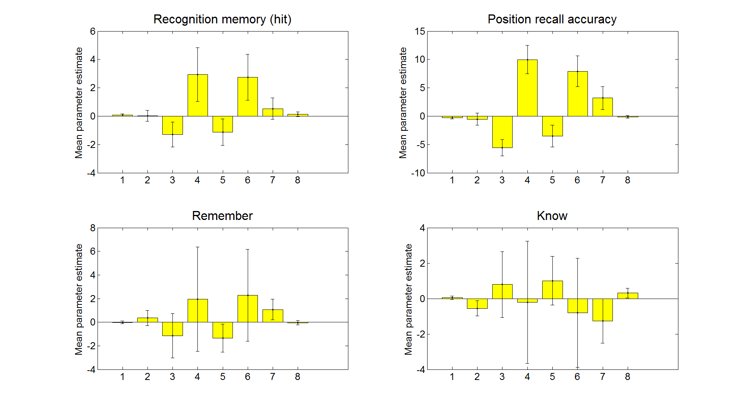
Mean betas for fig
v1
v2

Slide 10
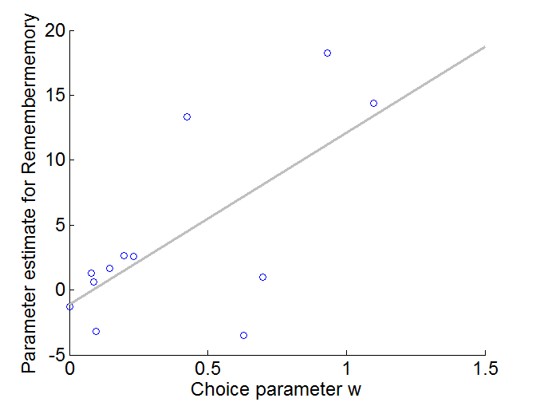
Does choice w parameter correlate with first-level memory estimates?
Kendalls tau: =0.42, i=.063
Model params forced positive

